Slide 1
Customer Retention
Analysis based on the code sheet

Slide 2
EDA STEPS

Slide 3
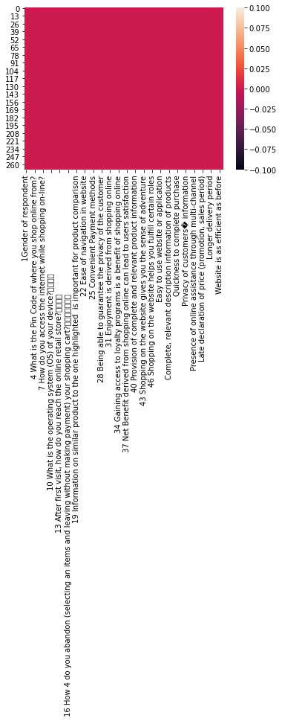
1- HEAT MAP OF DATA

Slide 4
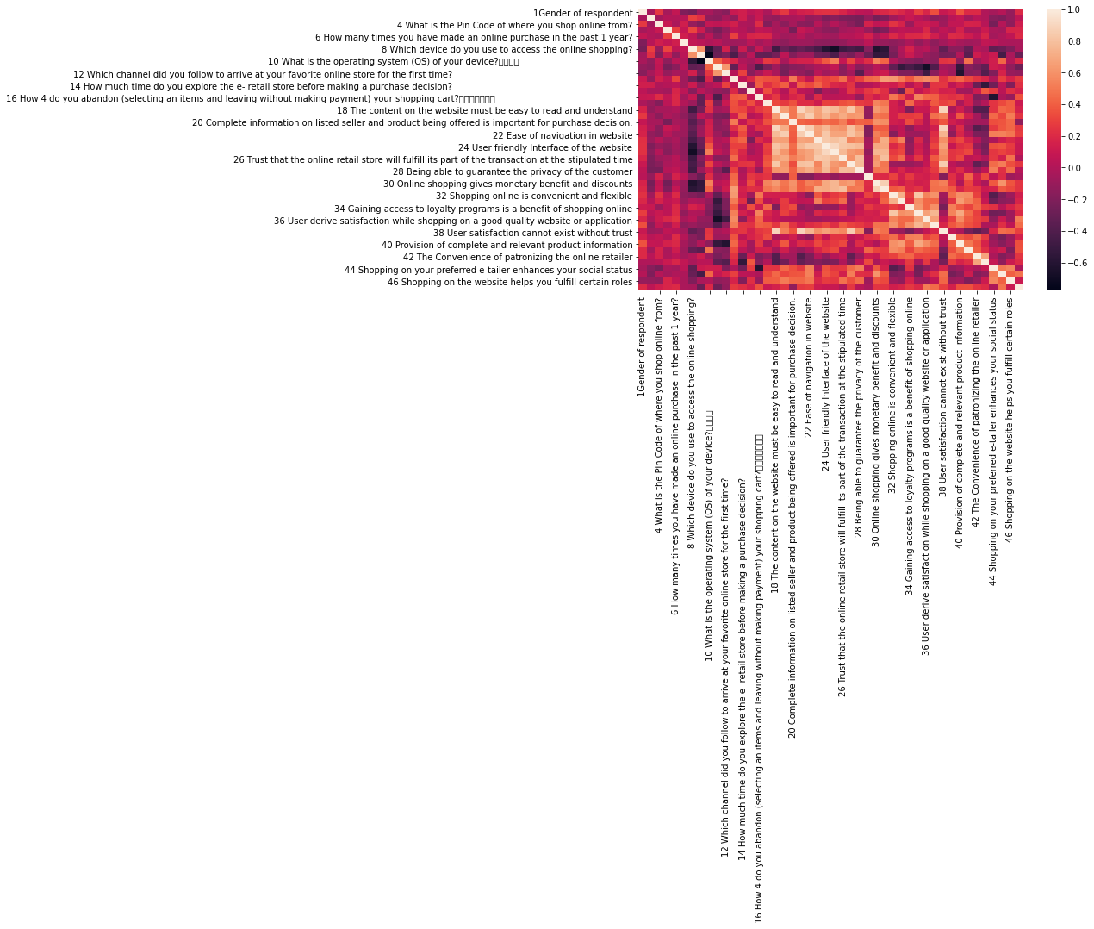
2- HEATMAP OF CORRELATION

Slide 5
OBSERVATION
lighter colors- high positive correlation
darker colors- high negative correlation

Slide 6
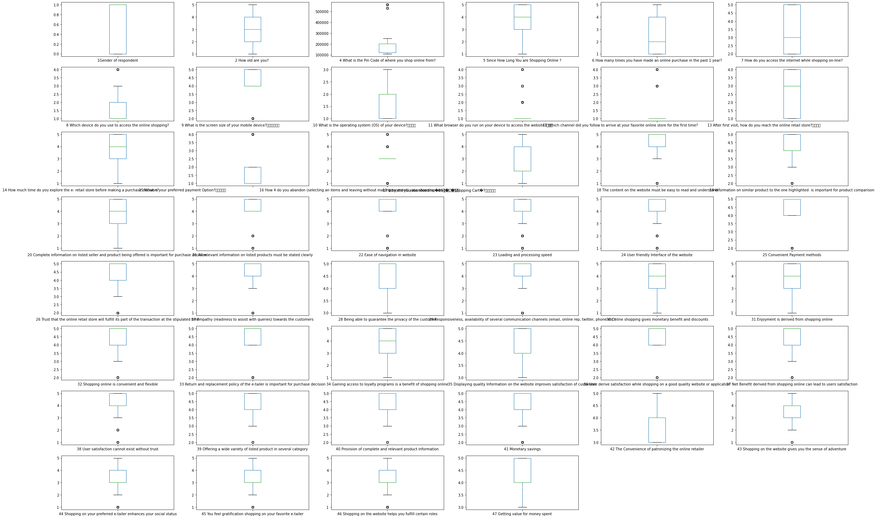
3- CHECKING OUTLIERS

Slide 7
OBSERVATION
observation- it shows the columns having values, exceeding the maximum values

Slide 8
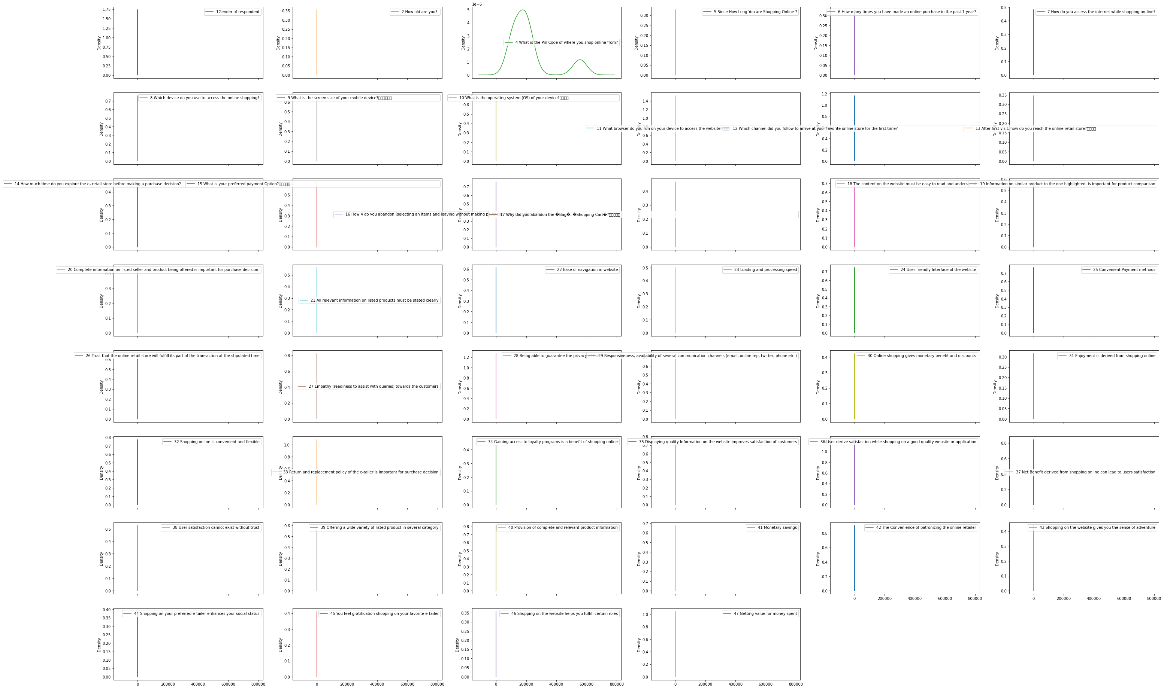
4- CHECKING SKEWNESS OF CORRELATED DATA

Slide 9
Data Analysis - Insights from the data

Slide 10
General insights from dataset

Slide 11
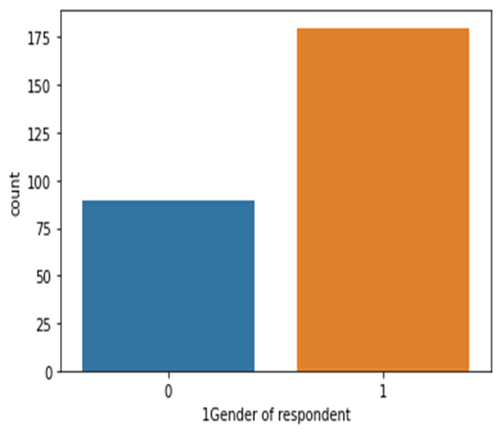
1- Gender count : (1)- female, (0)- male

Slide 12
Observation
observation
1- No. of female(1)- 180
2- No. of male(0)- 89

Slide 13
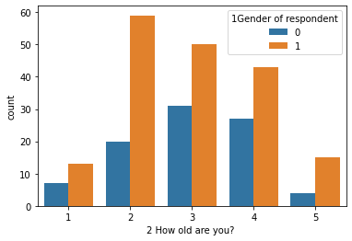
2-Age and Gender insight
points- "2 How old are you? "
1- less than 1 year
2- 1-2 years
3- 2-3 years
4- 3-4 years
5- Above 4 years

Slide 14
Observation
3- 81
2- 79
4- 70
1- 20
5- 19

Slide 15
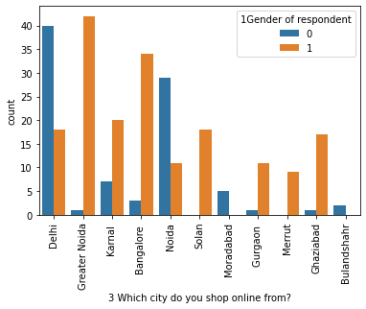
3-Cities and the people shopping insight

Slide 16
Observation
Delhi 58
Greater Noida 43
Noida 40
Bangalore 37
Karnal 27
Ghaziabad 18
Solan 18
Gurgaon 12
Meerut 9
Moradabad 5
Bulandshahr 2

Slide 17
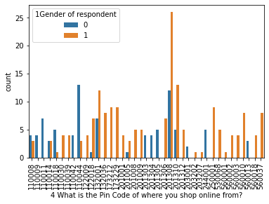
4-highest used pincode

Slide 18
Observation
Highest used pin code- 201308
Least used pin code- 203202

Slide 19
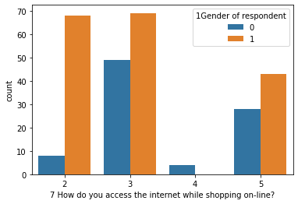
5-Gender and ways of accessing internet while shopping online
points- 7 How do you access the internet while shopping on-line?
2-wifi
3-mobile Internet
4-dial up
5-mobile internet

Slide 20
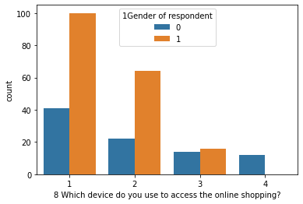
Which device do you use to access the online shopping?
Which device do you use to access the online shopping?
1-Smartphone
2-Laptop
3-Desktop
4-Tablet

Slide 21
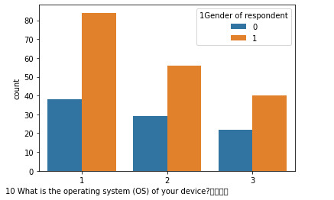
Operating system insight
What is the operating system (OS) of your device?
1- Window/windows Mobile
2- Android
3- IOS/Mac

Slide 22
Insights on agreement of people

Slide 23
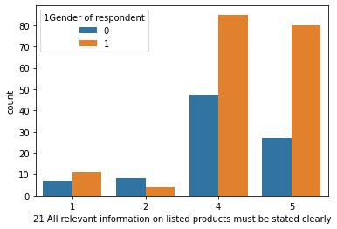
All relevant information on listed products must be stated clearly insights-
points-
1- Strongly disagree
2- Dis-agree
3- Indifferent
4- Agree
5- Strongly agree

Slide 24
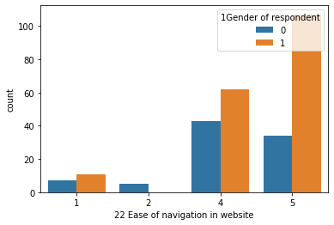
Ease of navigation in website-
points-
1- Strongly disagree
2- Dis-agree
3- Indifferent
4- Agree
5- Strongly agree

Slide 25
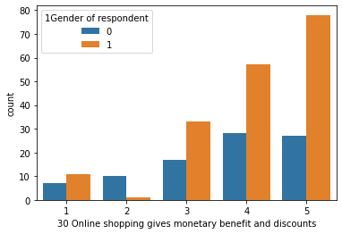
Online shopping gives monetary benefit and discounts insights-
points-
1- Strongly disagree
2- Dis-agree
3- Indifferent
4- Agree
5- Strongly agree

Slide 26
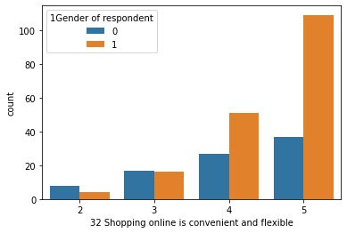
Shopping online is convenient and flexible insights-
points-
1- Strongly disagree
2- Dis-agree
3- Indifferent
4- Agree
5- Strongly agree

Slide 27
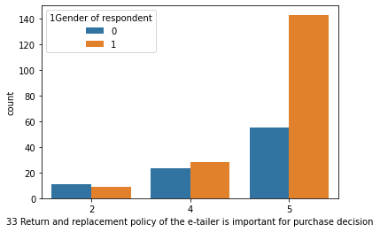
Return and replacement policy of the e-tailer is important for purchase decision insights-
points-
1- Strongly disagree
2- Dis-agree
3- Indifferent
4- Agree
5- Strongly agree

Slide 28
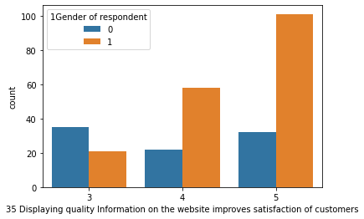
Displaying quality Information on the website improves satisfaction of customers insights-
points-
1- Strongly disagree
2- Dis-agree
3- Indifferent
4- Agree
5- Strongly agree

Slide 29
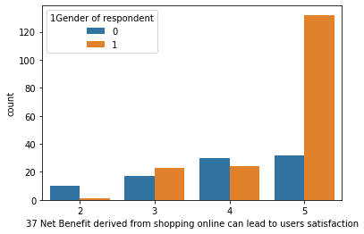
Net Benefit derived from shopping online can lead to users satisfaction insights-
points-
1- Strongly disagree
2- Dis-agree
3- Indifferent
4- Agree
5- Strongly agree

Slide 30
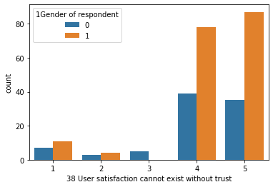
User satisfaction cannot exist without trust insights-
points-
1- Strongly disagree
2- Dis-agree
3- Indifferent
4- Agree
5- Strongly agree

Slide 31
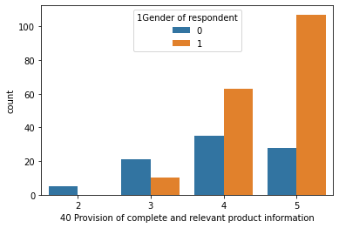
Provision of complete and relevant product information insights-
points-
1- Strongly disagree
2- Dis-agree
3- Indifferent
4- Agree
5- Strongly agree

Slide 32
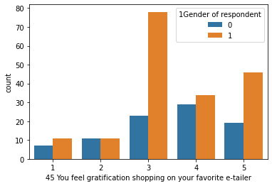
You feel gratification shopping on your favorite e-tailer insights-
points-
1- Strongly disagree
2- Dis-agree
3- Indifferent
4- Agree
5- Strongly agree

Slide 33
Analysis based on favourite websites of people

Slide 34
Easy to use website or application insights-

Slide 35
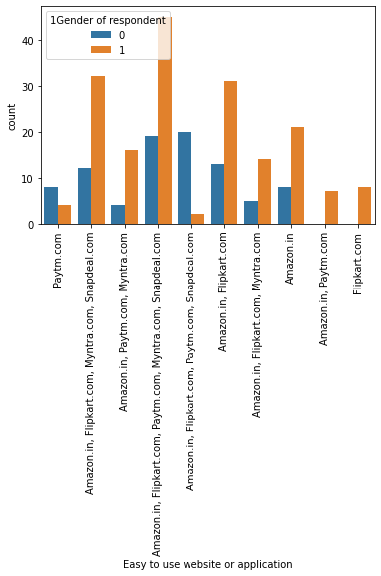

Slide 36
Fast loading website speed of website and application insights

Slide 37
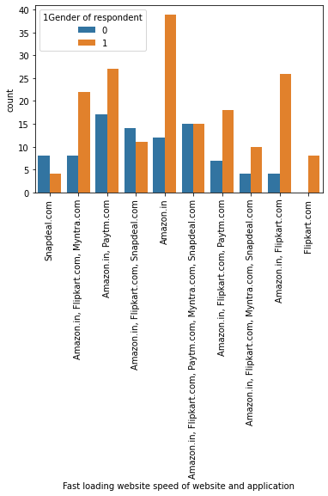

Slide 38
Reliability of the website or application insights-

Slide 39
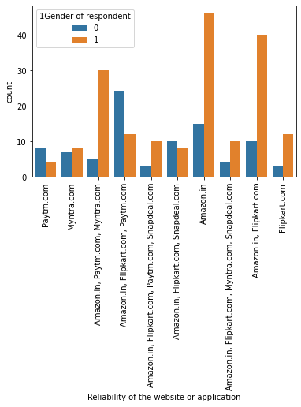

Slide 40
Speedy order delivery insights-

Slide 41
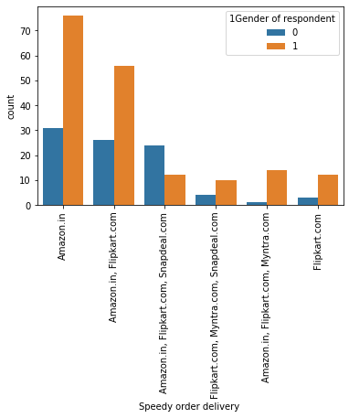

Slide 42
which site gives longest time in displaying graphics and photos insight

Slide 43
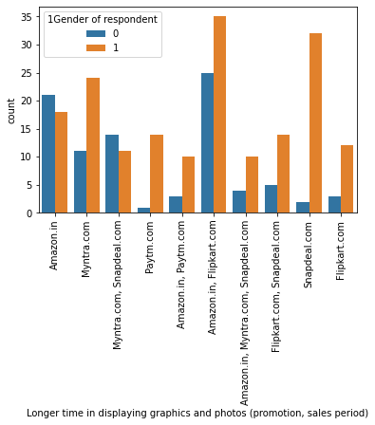

Slide 44
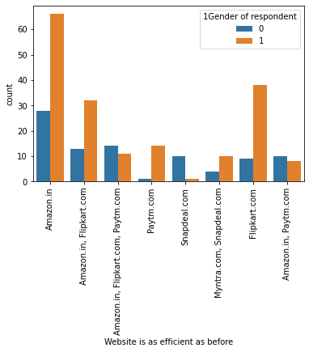
Website is as efficient as before insight-

Slide 45
Reliability of the website or application insight-

Slide 47
which site did they prefer to recommend to a friend insight-

Slide 48
